Slide 1
Interactive Large-Scale Data and Graph Analytics
Introduction
Oliver Alvarado Rodriguez, Naren Khatwani, Zhihui Du, David Bader

Slide 2


Slide 3
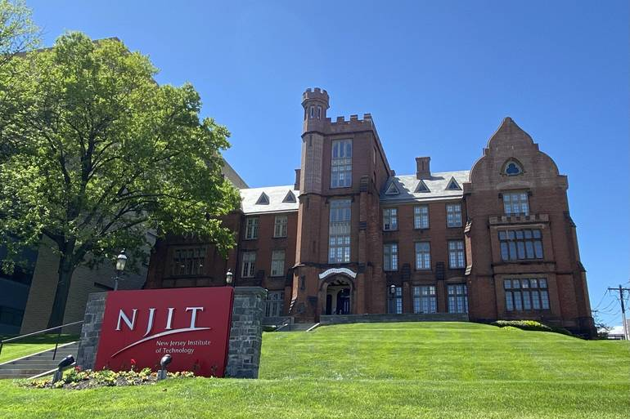
New Jersey Institute of Technology
“NJIT Climbs the Rankings of U.S. News & World Report, A Top 50 Public University” – 13 Sep 2021
“NJIT Named As One of Nation's 'Best Colleges' for 2022, The Princeton Review Says” – 6 Sep 2021

Slide 4

Center for Big Data
Big Data Analytics, Systems, and Tools
Cybersecurity Research Center
Practical encryption
The Structural Analysis of Biomedical Ontologies Center
Medical Informatics
NIH / National Cancer Institute
FinTech Group
Machine Learning & AI
Cyberinfrastructure
Privacy technologies
Information Assurance
Financial Services
Real-world technologies
Industrial partnerships
Insurance Industry
Launched in July 2019, with inaugural director David A. Bader
(~40 faculty in current centers)
Urban sustainability
Healthcare analytics
Trustworthy, Free and Fair Elections
Insider threat detection
Utility infrastructure protection
Cyberattack defense
Disease outbreak and epidemic monitoring
Solving real-world challenges

Slide 5


High Performance Algorithms for Interactive Data Science at Scale (PI: Bader) 3/2021 – 2/2023 NSF CCF-2109988
https://news.njit.edu/institute-data-science-aims-democratize-supercomputing-nsf-grant

Slide 6
Publications
Oliver Alvarado Rodriguez, Zhihui Du, Joseph Patchett, Fuhuan Li, David Bader (2022). Arachne: An Arkouda Package for Large-Scale Graph Analytics. IEEE HPEC.
Zhihui Du, Joseph Patchett, Oliver Alvarado Rodriguez, Fuhuan Li, David Bader (2022). High-Performance Truss Analysis in Arkouda. IEEE HiPC.
Joseph Patchett, Zhihui Du, Fuhuan Li, David Bader (2022). Triangle Centrality in Arkouda. IEEE HPEC.
Zhihui Du, Oliver Alvarado Rodriguez, David Bader (2021). Large Scale String Analytics In Arkouda. IEEE HPEC.
Zhihui Du, Oliver Alvarado Rodriguez, David Bader (2021). Enabling Exploratory Large Scale Graph Analytics through Arkouda. IEEE HPEC.
Joseph Patchett, Zhihui Du, David Bader (2021). K-Truss Implementation in Arkouda (Extended Abstract). IEEE HPEC.
Zhihui Du, Oliver Alvarado Rodriguez, Joseph Patchett, David Bader (2021). Interactive Graph Stream Analytics in Arkouda. Algorithms.
Zhihui Du, Oliver Alvarado Rodriguez, David A. Bader, Michael Merrill, William Reus (2021). Exploratory Large Scale Graph Analytics in Arkouda. CHIUW.
Notes:
Bolded on can be considered our “launch” paper.

Slide 7
Arkouda Developers
Michael Merrill – government
William Reus – government
John Yost – government
Elliot Ronaghan – Hewlett Packard Enterprise (Cray)
Benjamin McDonald – Hewlett Packard Enterprise (Cray)
Ethan DeBandi – government?
Franklin Pierce – government?

Slide 8
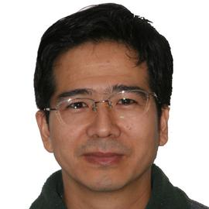

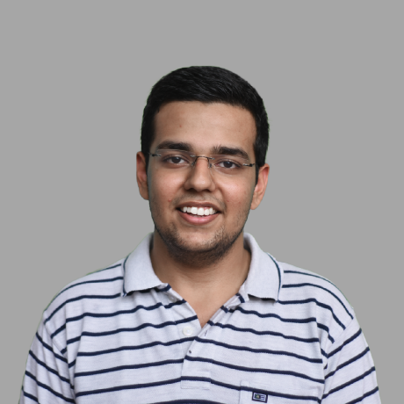
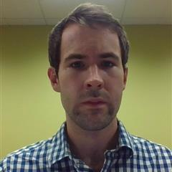
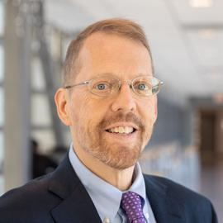
Arachne Developers
Zhihui Du
Research Scientist
NJIT
Oliver Alvarado Rodriguez
PhD Candidate
NJIT
Naren Khatwani
MS student
NJIT
Joseph Patchett
MS student (graduated)
NJIT
David Bader
Distinguished Professor
NJIT

Slide 9
Motivation 1: Massive-Scale Real-World Graphs
Public Health → epidemic/pandemic contact tracing networks (COVID-19, monkey pox, flu(s))
Sociology → massive social media networks, email communication networks
Bioinformatics → protein and genome networks
Neuroscience → brain connectivity networks
Urban Planning → electrical power grid networks
Scientometrics → co-authorship networks
Finance → transaction networks

Slide 10
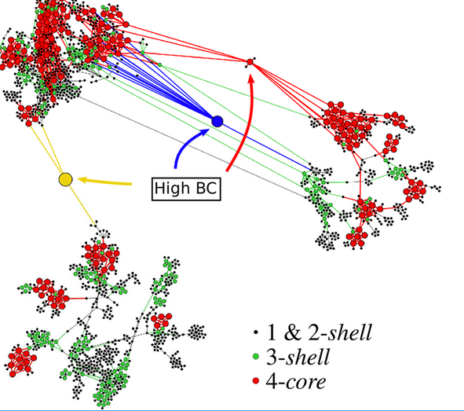
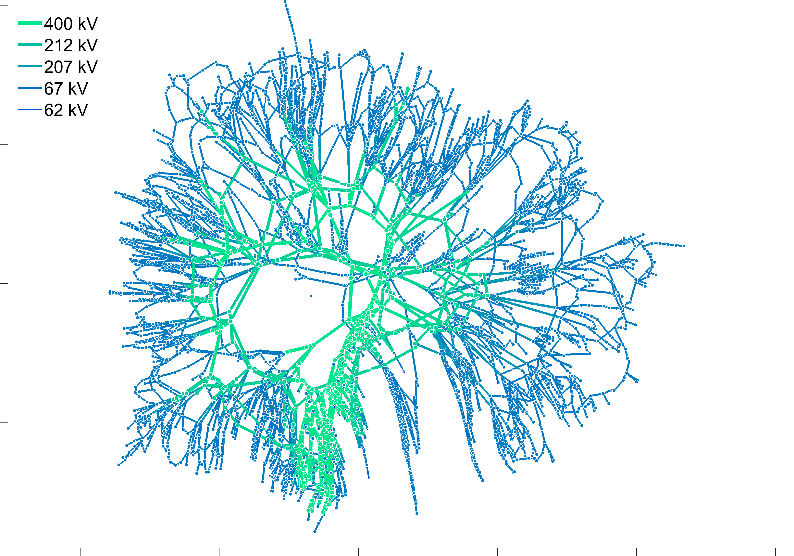
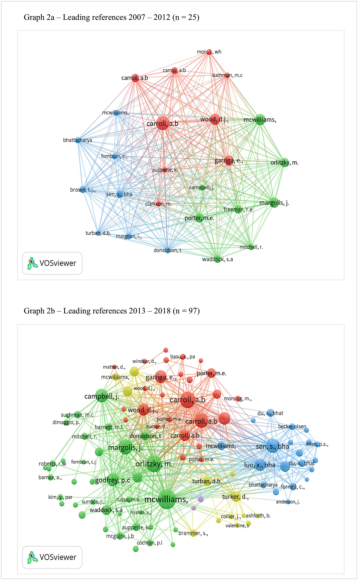
Motivation 2: Need for Graph Analytics
Analyzed infection network of COVID to find vertices with high betweenness centrality values that signified a super-spreader between communities [Serafino, Monteiro, et al. 2022].
Visualization of a high voltage transmission system to find the edges with maximum flow [Cuffe, 2016].
Finding the communities amongst authors in the area of corporate social responsibility [Ferramosca, Verona, 2019].

Slide 11
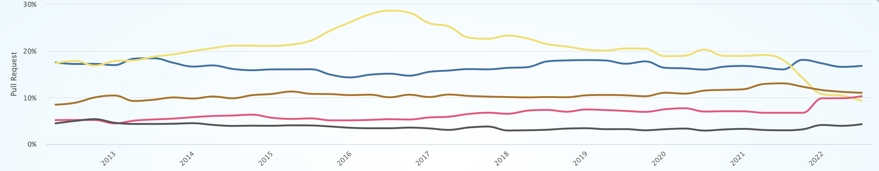
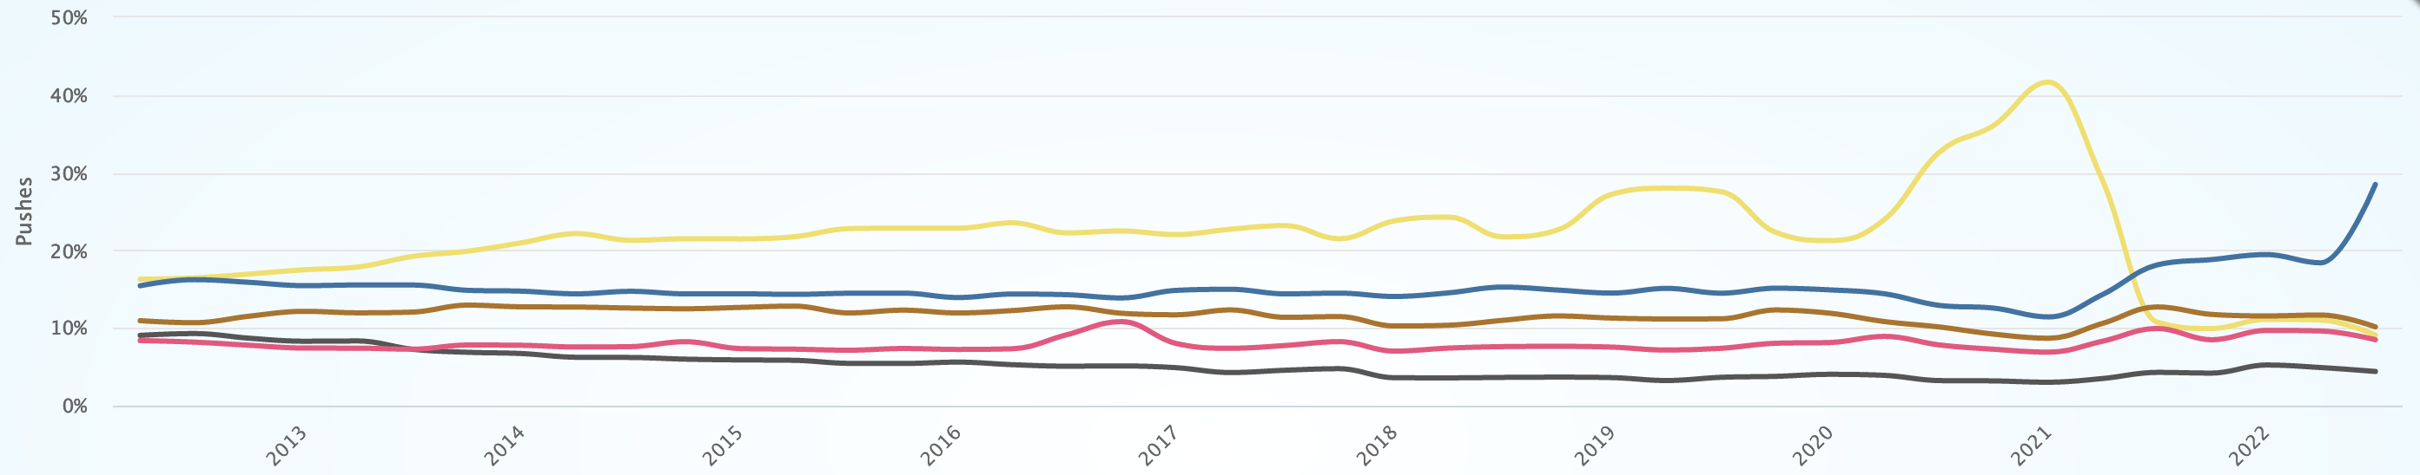
Motivation 3: Growing Usage of Python for Computing Sciences
Pull Requests
C --- C++ --- Java --- Javascript --- Python ---
Pushes
https://madnight.github.io/githut/#/pull_requests/2022/3

Slide 12
Motivations Overlap
we need insights from huge graphs
massive-scale real-world graphs
need for graph analytics
???
we fail to analyze massive graphs with Python
growing usage of Python for computing sciences
Python is the leading language for analysis
Notes:
Red and blue → more Python = more failed analysis of large graphs
Red and yellow → a lot problems can be solved through graph analysis
Blue and yellow → we have a lot of problems to solve, and we want to solve them through Python
Efficiently, effectively, and productively

Slide 13
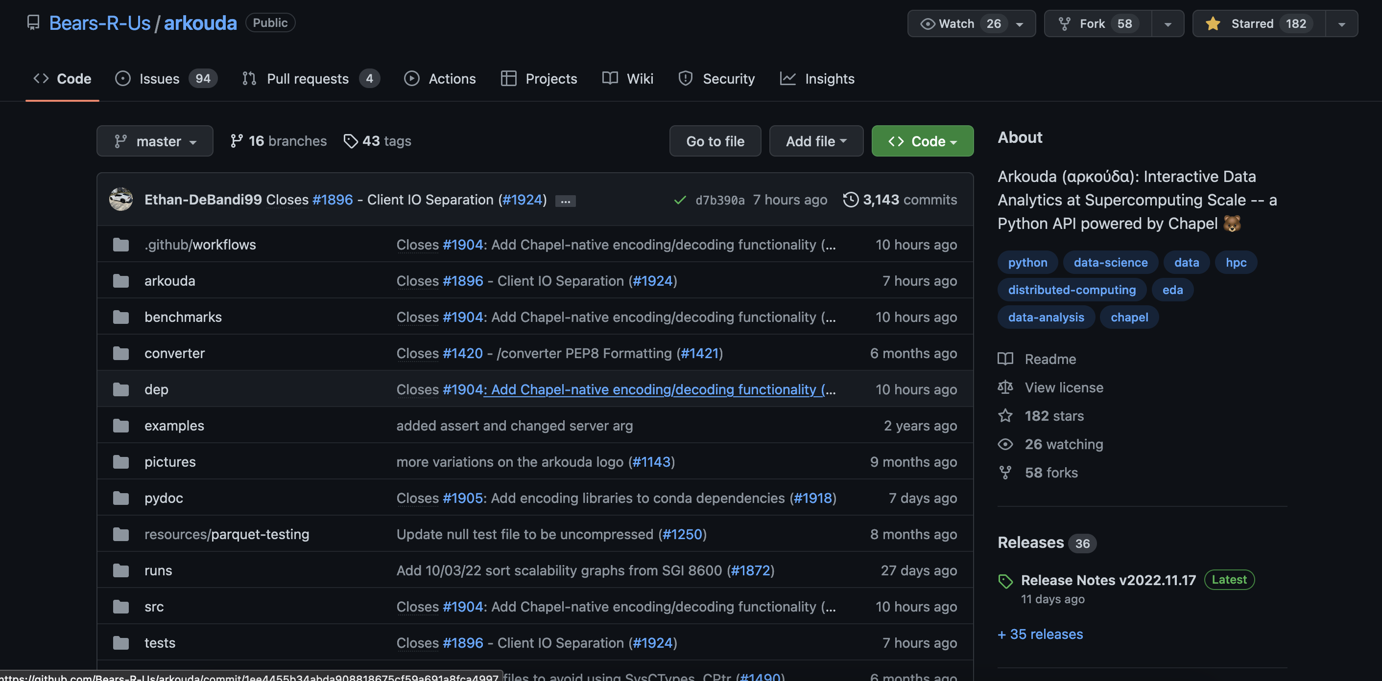
Arkouda: Interactive Data Analytics at Supercomputing Scale
https://github.com/Bears-R-Us/arkouda
Notes:
UPDATE IMAGE BEFORE PRESENTATION

Slide 14
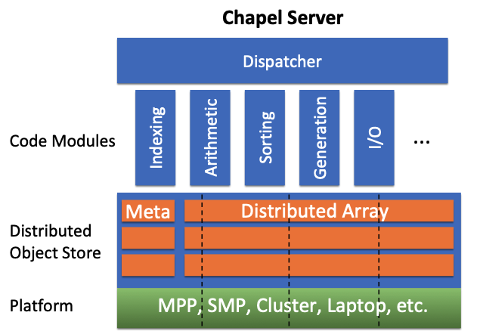

The Arkouda Framework with Arachne
Chapel Server
Jupyter
Or
Python3
Code
ZMQ
Overarching Dispatcher
Arachne
BFS
CC
K-Truss
…
Meta
Distributed Array
MPP, SMP, Cluster, Laptop, etc.
Arachne is built as an add-on with Arkouda and is fully interoperable.
Written in Chapel (productive & high-performance parallel programming language).
Image source: https://chapel-lang.org/CHIUW/2020/Reus.pdf

Slide 15
Arachne Infrastructure
Arachne Essential
Arachne Core
graph_bfs()
graph_cc()
graph_tri_cnt()
graph_tri_ctr()
stream_tri_cnt()
graph_truss()
graph_jaccard()
graph_file_read()
graph_file_read_mtx()
stream_file_read()
graph_file_preprocessing()
DI
file
pdarray | integer
graph_query()
benchmarks
timings across trials, correctness
edge | vertex arrays

Slide 16
Installing Arkouda (and Arachne)
Building Chapel and Arkouda from source adds flexibility to modifying the installation for specific architectures (single- vs multi-locale). Good for developers. Do on your own time.
Using Docker provides a very quick install-and-play version for quick usage that adapts well to the target architecture. Good for initial users and trying out the tool.

Slide 17
Running Arkouda Docker Image Steps
Install docker for Windows/MacOS/Linux.
Open terminal and run:
# set env variables
export ARKOUDA_IMAGE_REPO=bearsrus
export ARKOUDA_VERSION=v2022.11.17
docker run -it --rm -p 8888:8888 $ARKOUDA_IMAGE_REPO/arkouda-full-stack:$ARKOUDA_VERSION

Slide 18
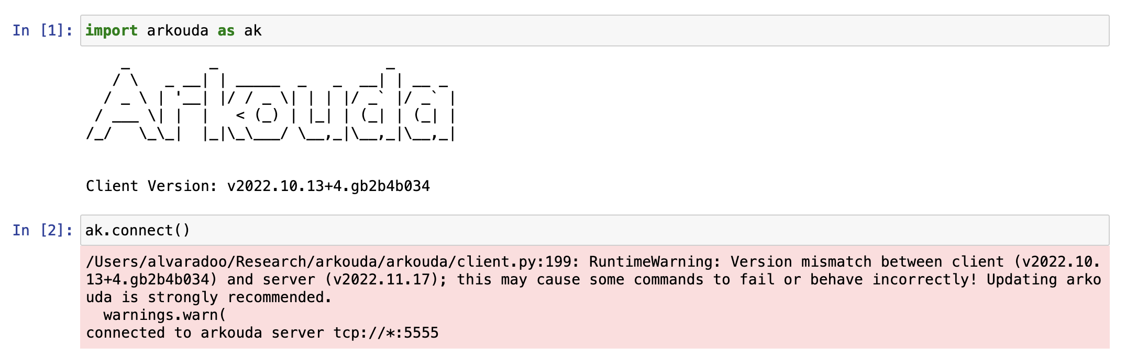
Connecting to Arkouda Server

Slide 19
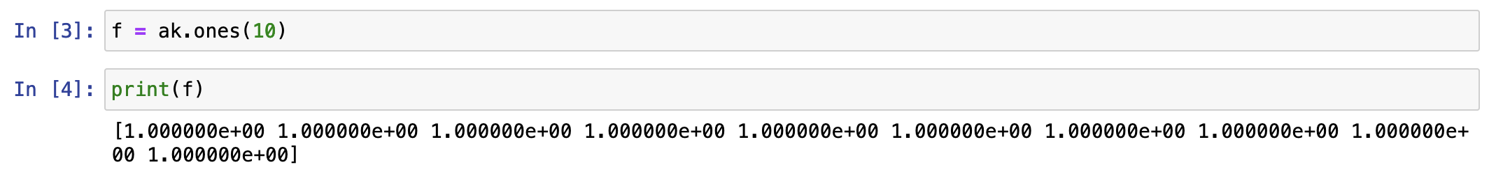
Running Small Example

Slide 20
Thank You ☺ Questions?

